Slide 1


Theory of Change Validation Conference & Workshop
Exploration, visualization and
modelling session

Slide 2
Types of variables
Quantitative
  Continuous – temperature, time (infinite intermediate values)
  Discrete – people, Training sessions (can’t have 1.2 people!)
Categorical
  Hierarchical – Ordered values (high/med/low, Country/Department/City)
  Unordered – No particular order (gender, status)
Descriptive
  Something that qualifies the points, or measures how good a data-point is (margin of error, number of votes)

Slide 3
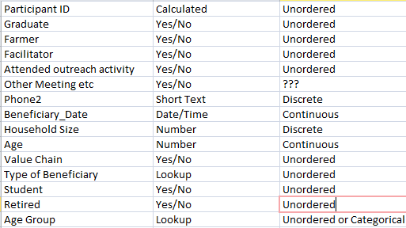
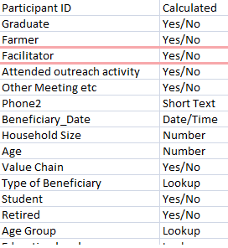
Variable type practice
Paste a db table

Slide 4
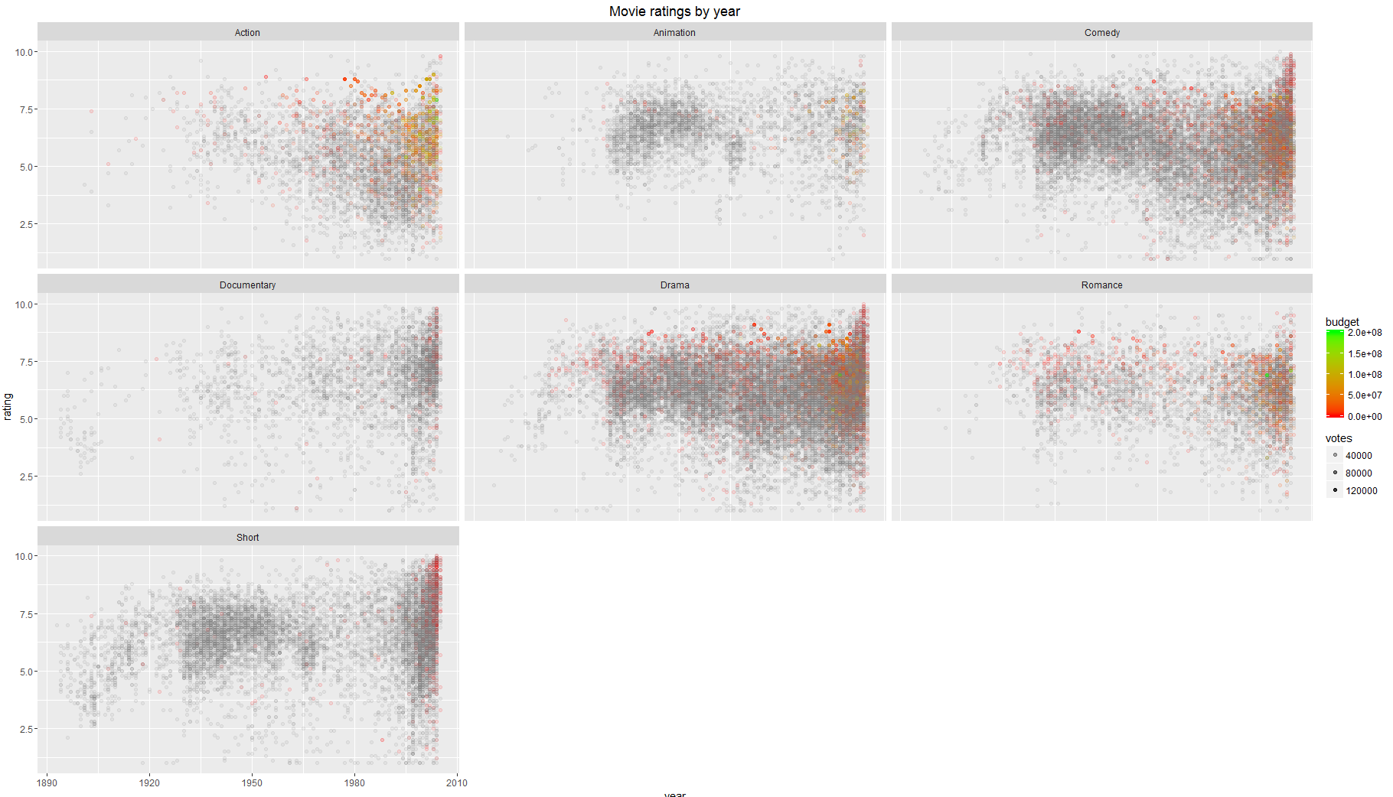
  EXERCISE 1: 5 minutes
  ~65 000 movies facetted by genre (movies with multiple genres show up in each facet).
  Describe using: Continuous, Discrete, Hierarchical, Unordered, Descriptive

Slide 5
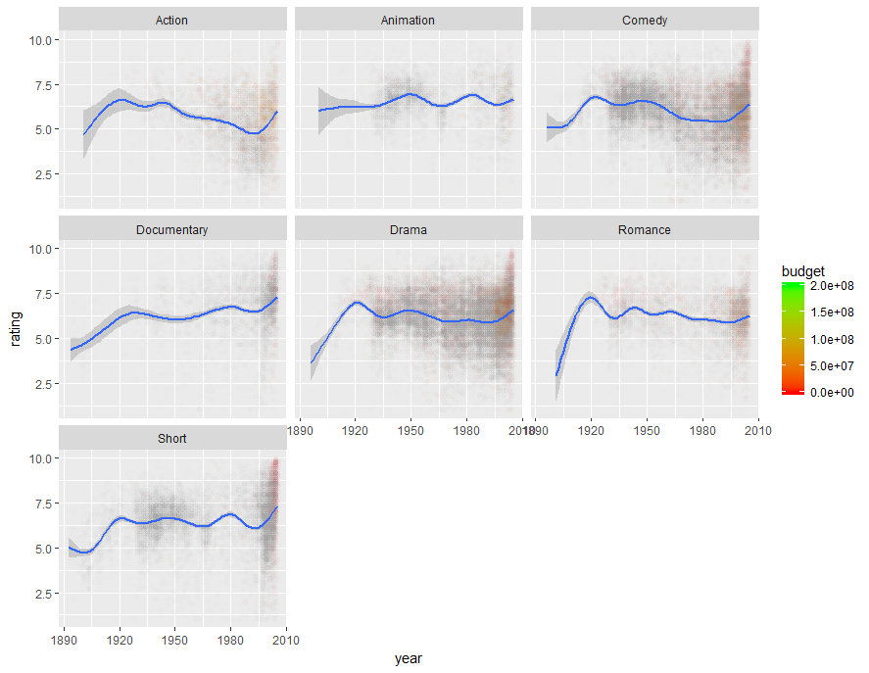
  TREND

Slide 6
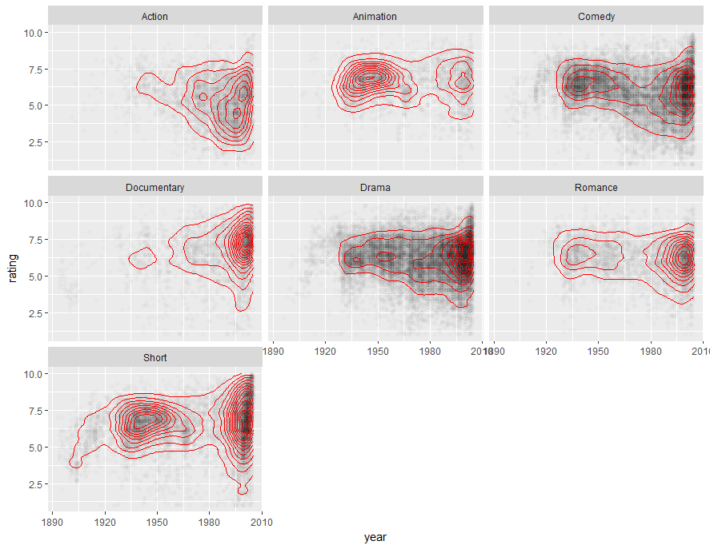
  DISTRIBUTION

Slide 7
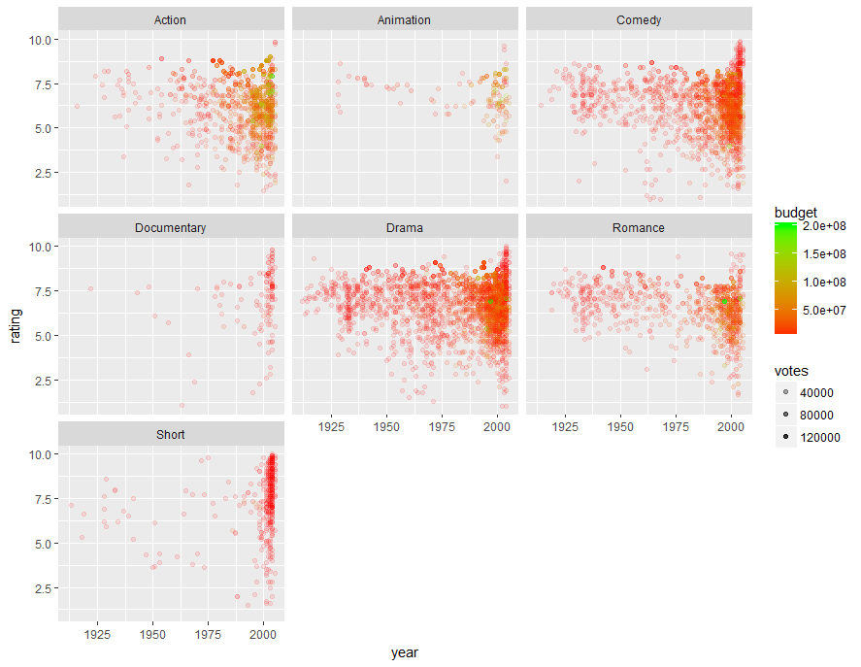
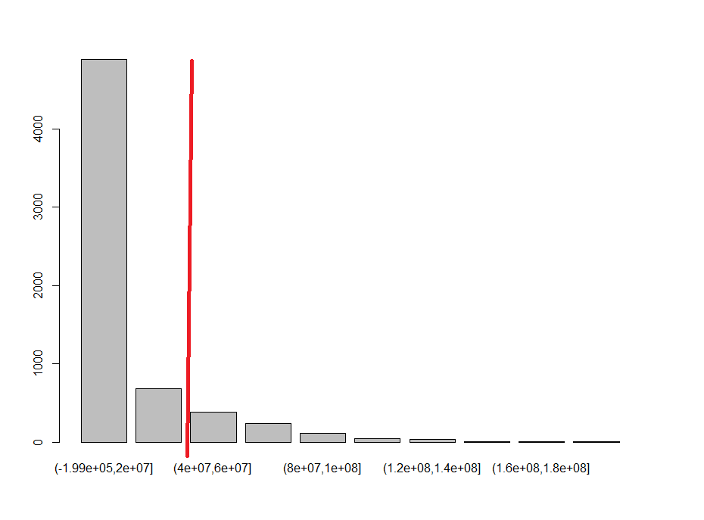
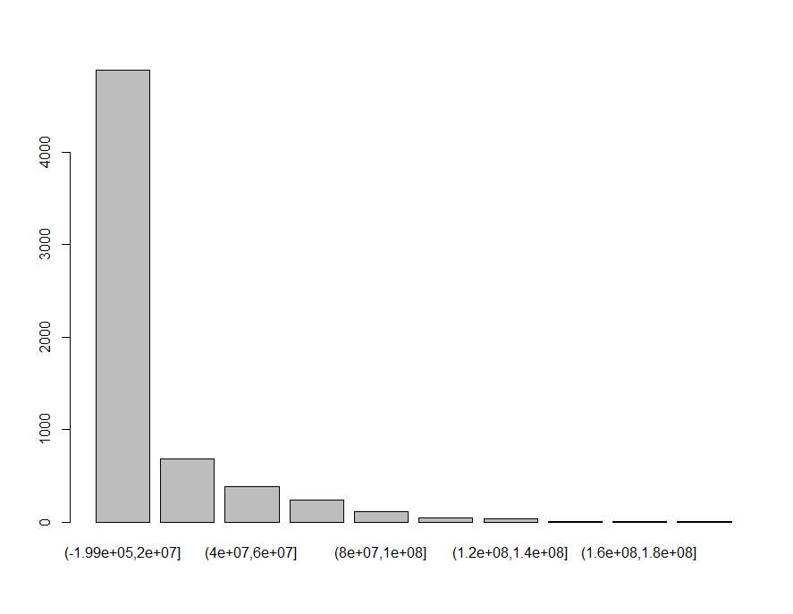
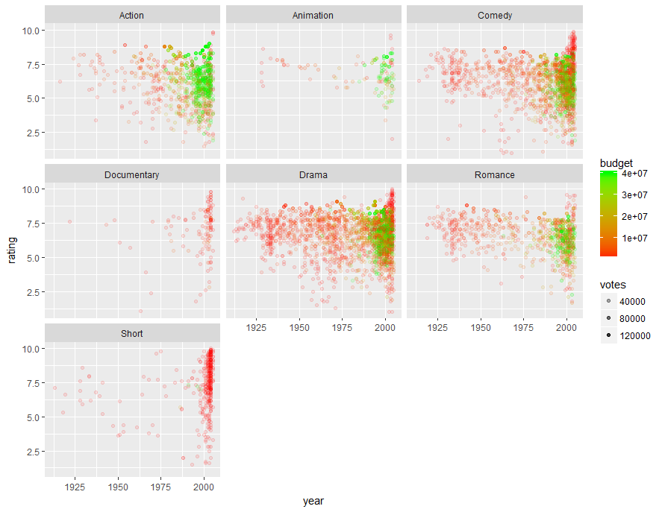
  SOMETIMES TRUNCATION
  IS NECESSARY
  COLOR, but…

Slide 8
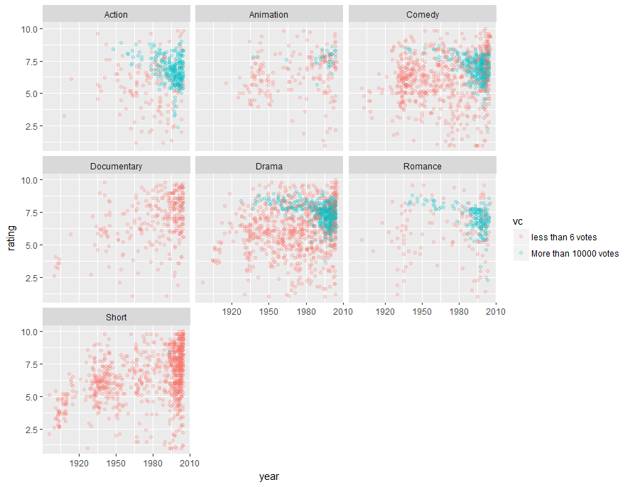
  FEATURE CREATION

Slide 9
What is the point?
WINS + LEARNING
If we found insight, then WIN
If we didn’t find insight?
  ASK MORE QUESTIONS!

Slide 10
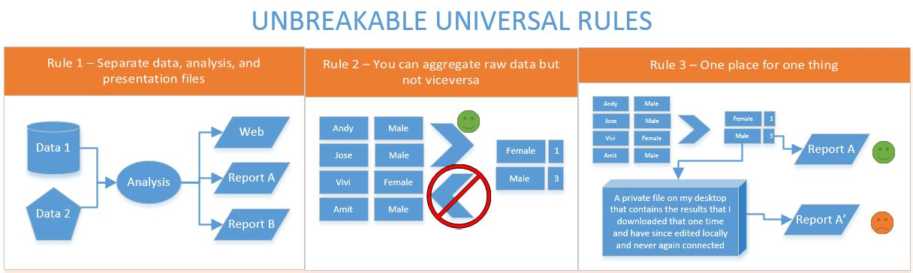
Rules of data management
< COPY PASTE IN>

Slide 11
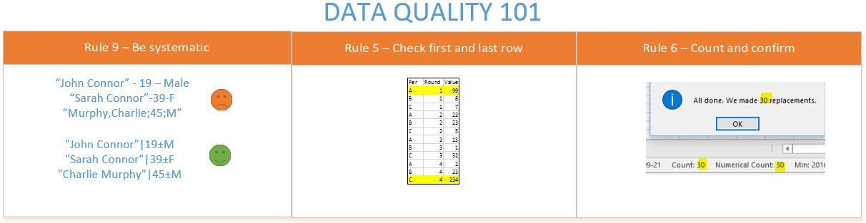
Rules of data management (continued)

Slide 12
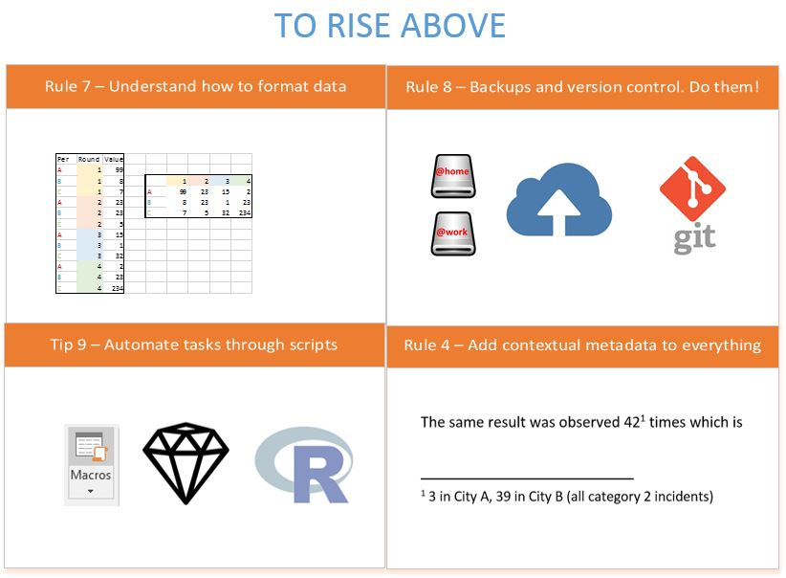
Rules of data management (continued bis)

Slide 13
Exercise 2 – Workflow (10 min)
Individual work (5 min):
  Draw your workflow
  What areas do we need to modify?
Group discussion (10 min)

Slide 14
Practical example (follow along example)
We have a database with some beneficiaries and some training sessions. The training sessions have topics. We have also given some loans to some beneficiaries. We have gone out and measured technology application in the field in a survey.
We want to know:
  Is all the data ok?
  Does training affect technology application? Do loans? Do both together?
  Does it help apply technology if we train beneficiaries more than once?
  MAYBE some slight modelling?

Slide 15
Practical Example (cont)
So how we gonna do it?
Combine data
  Address harmonization issues, if any
  Learn from errors?
Format the data
Analyze, Exploratory Data Analysis (EDA)
Visualize
Model

Slide 16
Skills
Duplicate Identification
Duplicate Prevention
Dealing with imperfections – Human issues
Data re-dimensioning via Pivoting
Visualization & Mapping

Slide 17
www.acdivoca.org
Since 1963 and in 146 countries, ACDI/VOCA has empowered people to succeed in the global economy.

